Slide 1

Welcome
Abhishek Gadwal | Lead Engineer

Slide 2
What is Tosca
TOSCA (Test Orchestration, Automation and Standardization) is a framework for automated testing that provides a model-based approach for defining, designing and managing test cases. Tosca Testing is a methodology and toolset that aims to streamline the entire testing process by focusing on standardization, reusability and automation .

Slide 3

Types of workspaces
Tricentis Tosca offers two types of workspaces:
Single-user workspaces for environments
where only one person needs access to data.
Multi-user workspaces for environments where several people need access to the same data. In multi-user workspaces, a check in / check out mechanism ensures that users don't interfere with each others work

Slide 4
Single User Workspace
To create a single-user workspace, follow the steps below:
On the Tosca Commander start screen, go to Project->New.
Create new workspace window, "select None (creates single user workspace)" and "select repo and connection string given by client (creates Multiple user workspace)" from the Select type of Repository drop-down menu.
After a standard installation,
Tricentis Tosca creates new workspaces in the default directory C:\Tosca_Projects\Tosca_Works paces. You can specify a different directory in the Create new workspace in field.
Enter a unique name for your workspace into the Select name for new workspace field.
If you create a new workspace for a new repository, the option Use workspace template is available.
Enable this option if you want to automatically import the Standard subset into the new workspace. You can also select a different subset.
Click OK.

Slide 5

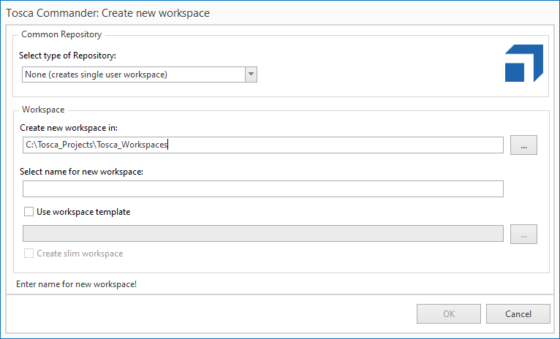

Slide 6
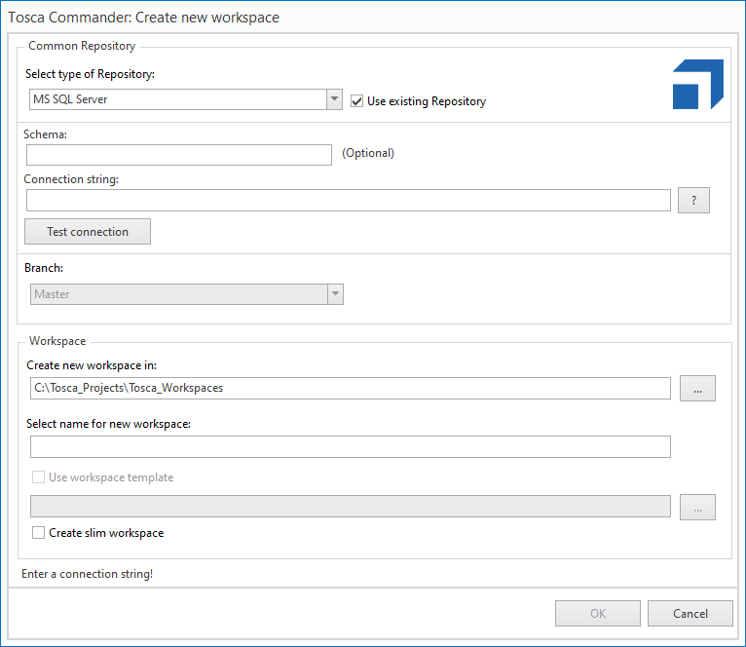
Multiuser
Workspace

Slide 7

The checkin / checkout mechanism in multi-user workspaces ensures that users don't interfere with each others work:
Checkout objects you want to work on. These objects are now locked; other users can't modify them for as long as they are checked out.
Checkin objects once you're finished with them. This
frees them up for other users.
You can also update your workspace or view checkout and change information on the objects in your workspace.

Slide 8
Tosca Commander - It is used for creating projects.
Tosca Executor – It is used for executing the test cases.
Tosca X Scan (Tosca Wizard) – It is used for scanning input fields and save the information as modules.
Test Repository – It is used for saving all the workspaces
Components of Tosca

Slide 9
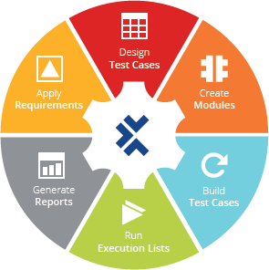
Sections in Tosca

Slide 10
The TestCases section, is where you create your
TestCases, which are made up of a series of TestSteps.
The Modules section,, allows you to create modules for use in Testcases. These modules contain technical information that is used to steer test objects.
The Execution section, is where the actual test execution is performed. In this section, you can see the logs and results of your tests. You can also conduct exploratory testing or boost your performance with distributed execution in this section.
The TestCase-Design section,, enables you to put your test cases into a logical structure. In this section, you can create a TestSheet to show all possible combinations of TestCases required to ensure full test coverage.
The Requirements section, allows you to specify requirements for your TestCases as well as to assign risk coverage for efficient testing.

Slide 11




Types of Modules
In Tricentis Tosca we have two types of
Modules: Standard module and Created module
Standard Modules : Pre built modules provided by tosca for common task.
Created Module : Modules that we created by scanning our application

Slide 12

Identify controls in Tosca XScan
In Tosca XScan, you can identify controls in your test application by using multiple identification methods. The identification of controls by their properties is the default identification method in Tosca XScan. However, if your controls cannot be identified uniquely by via their controls, there are additional ways to identify controls. .
You can identify controls in the following ways:
Identify by Properties
Identify by Anchor
Identify by Image
Identify by Index

Slide 13
Identify by Properties-This window contains all the
technical information and properties of the selected control.
Identify by Anchor-In this window you can transfer identification criteria from one control (source control) to another control
Identify by Image-You can define an image to be used for
identifying controls
Identify by Index- If a selected control does not have a unique ID, you can select an index to be used upon test execution to identify the control. Enable the checkbox next to Index to select the index.

Slide 14

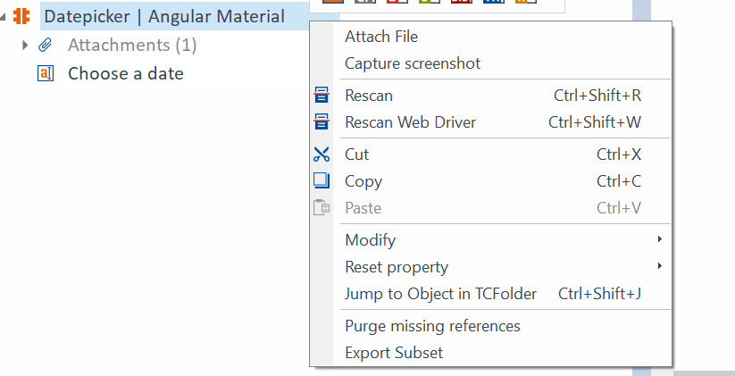
Rescan Modules
In Tricentis Tosca you can update existing Modules along with their ModuleAttributes, or add new ModuleAttributes by using Rescan.
Make sure that the object to be tested is available, and that the screen you scanned with this Module is ready.
In Tosca Commander right-click on the Module to be synchronized and select the option Rescan from the context menu.
Tosca Rescan will open and scan the open screen.

Slide 15
Action Modes perform reading or input operations on a control. Reading operations read the property that is defined for a control. Input operations modify the defined property during test execution.
INPUT
BUFFER
VERIFY
WAITON
CONSTRAINT
SELECT
Action modes in tosca

Slide 16
INPUT-The Action Mode Input can be used to transfer values to the test object
SELECT-The Action Mode Select allows you to select specified nodes
Verify-The Action Mode Verify allows values and control properties in test objects to be verified
WAIT ON-The system waits until the control value matches the value specified in the Value column.Used to perform dynamic waits .Used to wait for entered value or message or control to visible
CONSTRIANT- It allows you to identify one specific item in a list of similar items. The item you are looking for needs to be uniquely identifiable .
Buffer-It allows us to save and reuse the value .This makes verification flexible .Instead of using hard coded data. Save generated value by using buffer.
Syntax:{B[Buffername]}
Action modes in tosca :
Explanation

Slide 17
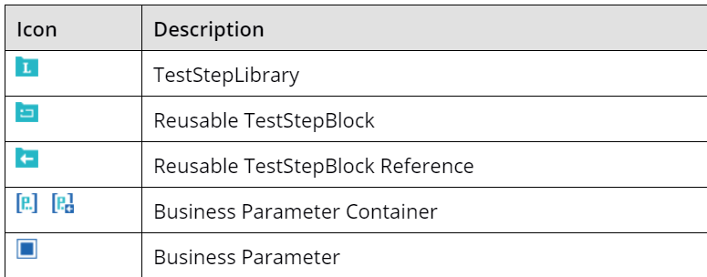
Libraries
Create Library where we can store reusable steps. The benefits is that whenever we want to use/reuse ,Simply drag and drop them.
TestStep Libraries are made up of Reuseable TestStepBlocks which can be used to create Test Cases.
Library can contains any number of “Resuable Teststep blocks.

Slide 18
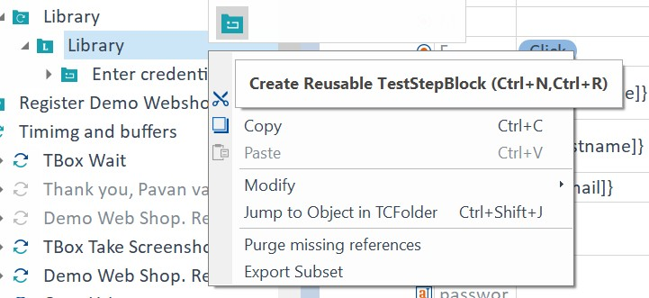
Reusable test step blocks
To use a TestStepLibrary, you need to create Reusable TestStepBlocks that are made up of TestSteps.
To create a Reusable TestStepBlock, right-click onto a TestStepLibrary and select Create Reusable TestStepBlock from the mini toolbar.

Slide 19
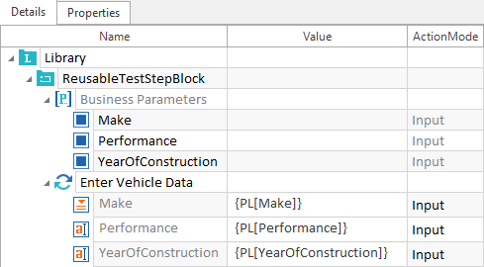
Business Parameters
Business parameters are used to pass dynamic values in test step blocks.
Dynamic values are displayed and managed separately from the TestStepValues
{PL[<Business Parameter Name>]}-
Syntax

Slide 20

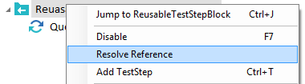


Resolve Reference
References to Reusable TestStepBlocks can be resolved. In this case, a copy of the TestSteps is made, which can be arbitrarily edited and is no longer linked to the TestStepLibrary.
Select the reference to be resolved.
Select Resolve Reference from the context menu.

Slide 21
Thank You
Abhishek Gadwal | Lead Engineer

